Slide 1




What do archaeological and genetic data tell us about the dispersal and interbreeding behaviour of early Mediterranean farmers?
Joaquim Fort
Universitat de Girona (Catalonia, Spain)
EAA annual meeting
Belfast, 31 August 2023
Grant PID2019-104585GB-I00 funded
by MCIN/AEI/10.13039/501100011033

Slide 2
This talk has 2 parts
1st PART: Archaeological data make it possible to quantify the dispersal behaviour.
2nd PART: Genetic data make it possible to quantify the interbreeding behaviour.

Slide 3
1st PART: Archaeology
· New database.
· 215 early Neolithic sites.
· 3 new regions: 1, 2, and 4 (not included in our PNAS 2017).
· Oldest date per region on a domesticated, short-lived species.
Region | uncal BP | error | cal. BC max | cal. BC min | site
1 Southwestern Italy | 6956 | 75 | 5991 | 5676 | Favella della Corte
2 Central western Italy | 6809 | 45 | 5774 | 5626 | Colle Santo Stefano
3 NW Italy/SE France | 6870 | 40 | 5842 | 5665 | Arene Candide
4 Languedoc/Roussillon | 7010 | 60 | 5995 | 5746 | Pont de Roque-Haute
5 Catalonia | 6655 | 45 | 5642 | 5481 | Guixeres (de Vilobí)
6 Valencia | 6600 | 50 | 5622 | 5478 | Mas d'Is
7 Andalusia | 6609 | 35 | 5620 | 5479 | Dehesilla
8 southern Portugal | 6550 | 70 | 5624 | 5374 | Cabranosa
9 central Portugal | 6497 | 34 | 5529 | 5372 | Lameiras

Slide 4
Spread rate
straight line is the regression:
9.1 km/yr
r = 0.84
Bootstrap resampling using the calibrated probability
distribution for each site: 7.5-10.6 km/yr
(80% CL).
We will use this range in other slides.
The mean is 9.1 km/yr, the same as the regression value above.
Fort, Arch. Anthropol. Sci. (2022)

Slide 5
Simulations
Both in the analytical model and the simulations, we consider:
· a rectangular grid of square cells.
· initially farmers only at the lower row.
· All other grid cells are initially empty of farmers and with HGs at their saturation density.
· At each node in the grid and time step (of 1 generation =32 yr), we compute 3 processes:
(1) Reproduction: logistic, with net fecundities Ro=e ^{aT} = 2.45 for farmers and R'o=e ^{a'T} = 1.81 for HGs (from ethnographic data), where a and a' are the growth rates.
Carrying capacities: 1.28 farmers/km², 0.064 HGs/km² (from ethnography). They do not have any effect on the spread rates, neither does R'o.

Slide 6
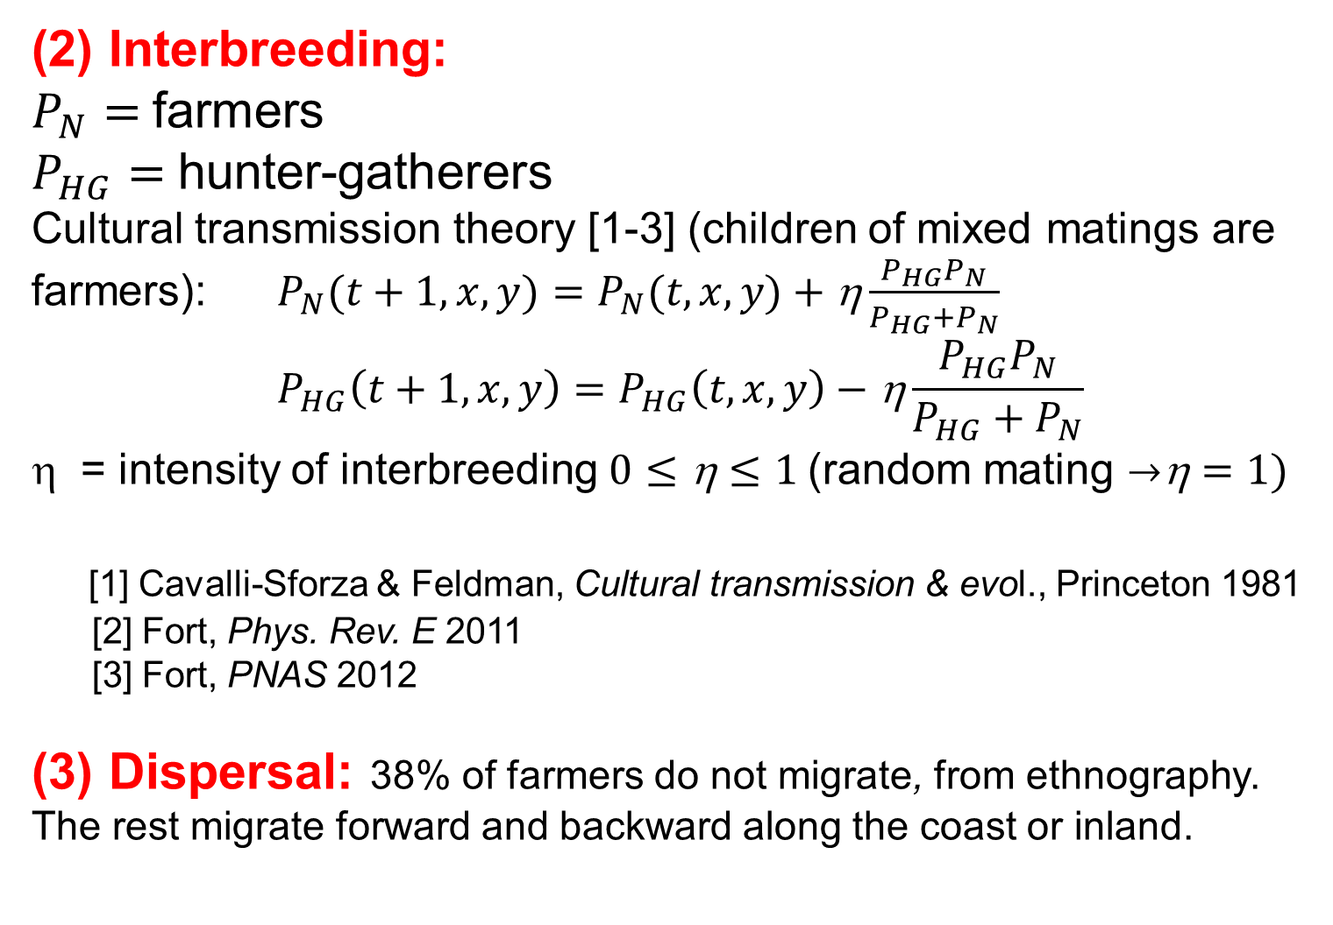
Simulations
(2) Interbreeding:
$P_{N}=$farmers
$P_{HG}=$hunter-gatherers
Cultural transmission theory [1-3] (children of mixed matings are farmers): $P_{N}(t+1, x,y)=P_{N}(t, x,y) \text{+} \text{η}\frac{P_{HG}P_{N}}{P_{HG}+P_{N}}$
$$P_{HG}\left(t+1, x,y\right)=P_{HG}\left(t, x,y\right)−\text{η}\frac{P_{HG}P_{N}}{P_{HG}+P_{N}}$$
= intensity of interbreeding $0≤\text{η}≤1$(random mating $\text{}=1)$
[1] Cavalli-Sforza & Feldman, Cultural transmission & evol., Princeton 1981
[2] Fort, Phys. Rev. E 2011
[3] Fort, PNAS 2012
(3) Dispersal: 38% of farmers do not migrate, from ethnography. The rest migrate forward and backward along the coast or inland.

Slide 7
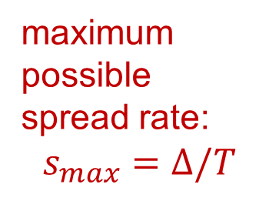
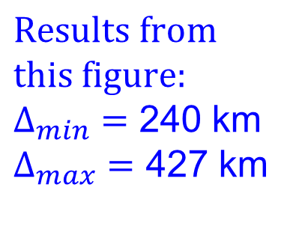
Results from Archaeology
maximum
possible
spread rate:
$$s_{max}=Δ/T$$
archaeological data: 7.5-10.6 km/yr
(slide #4)
$$Results from$$
$$this figure:$$
$Δ_{min}=$ 240 km
$Δ_{max}=$ 427 km
Fort, Arch. Anthropol. Sci. (2022)

Slide 8
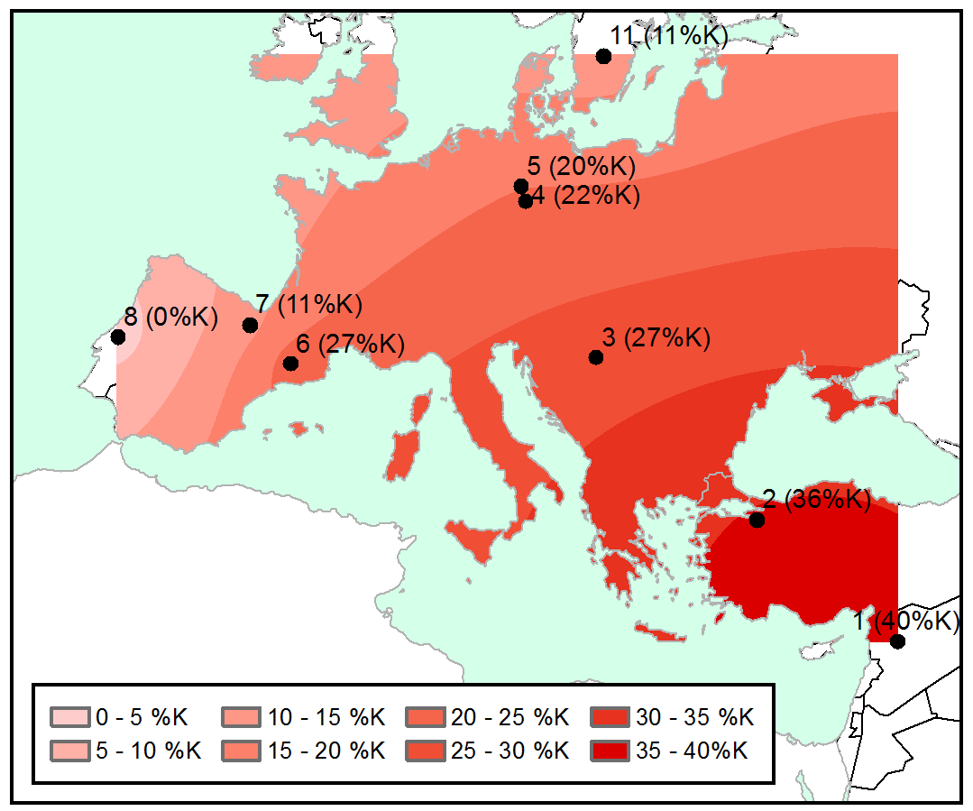
2nd PART: Genetics (ancient DNA)
mtDNA haplogroup K: absent in hunter-gatherers
This
pattern
suggests
interbreeding
Isern,
Fort &
de Rioija,
Sci. Rep. (2017)

Slide 9
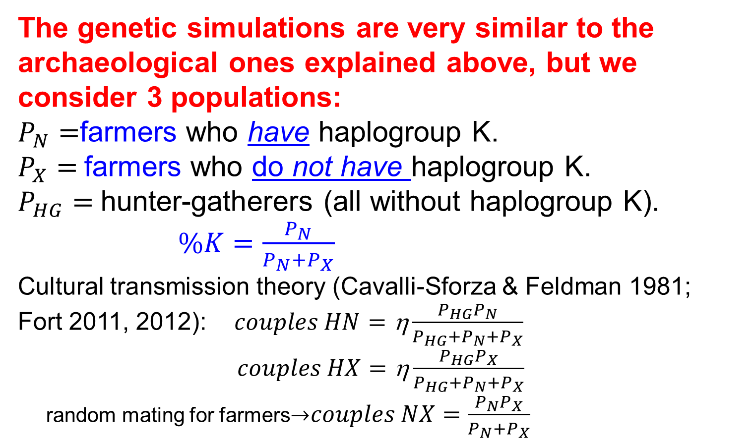
Simulations
The genetic simulations are very similar to the archaeological ones explained above, but we consider 3 populations:
$P_{N}=$farmers who have haplogroup K.
$P_{X}=$farmers who do not have haplogroup K.
$P_{HG}=$hunter-gatherers (all without haplogroup K).
$\%K=\frac{P_{N}}{P_{N}+P_{X}}$
Cultural transmission theory (Cavalli-Sforza & Feldman 1981;
Fort 2011, 2012):$couples HN=\text{η}\frac{P_{HG}P_{N}}{P_{HG}+P_{N}+P_{X}}$
$couples HX=\text{η}\frac{P_{HG}P_{X}}{P_{HG}+P_{N}+P_{X}}$
random mating for farmers$couples NX=\frac{P_{N}P_{X}}{P_{N}+P_{X}}$

Slide 11
Inland genetic cline
Fort &
Pérez-Losada
(2023)
Best fit: η = 0.07

Slide 12
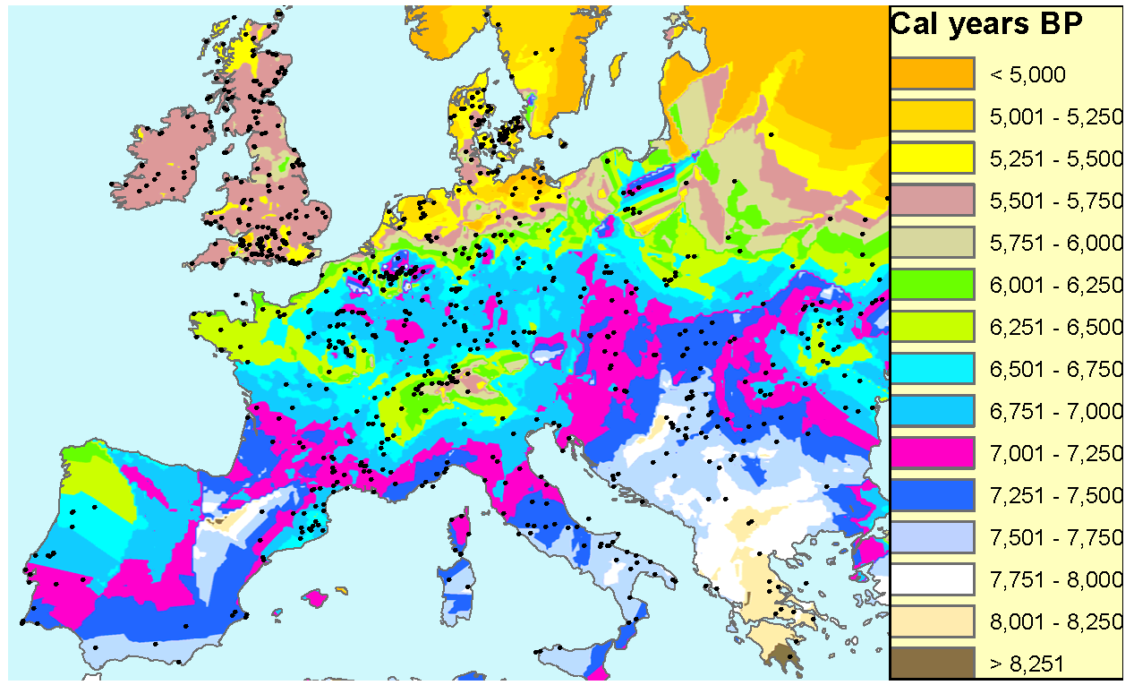
Two routes
inland
route
sea route
Now we have ancient genetic data for both routes: 961 individuals

Slide 13
Mediterranean genetic cline
Fort &
Pérez-Losada
(2023)
Best fit: η = 0.07 again!

Slide 14
Sensitivity analysis
We have analyzed the effects of:
-initial conditions: uncertainty of the initial %K (Syria)
-parameter values:
-dispersal threshold
-net fecundity of farmers
-carrying capacity of farmers
-carrying capacity of hunter-gatherers
The results are similar.
The conclusions do not change.

Slide 15
Conclusions
Archaeology tells us that:
Concerning dispersal, geography was very important:
early farmers moved longer distances per generation along the sea route. This is why the spread rate along the sea route (9 km/yr) was much faster than in the inland route (1 km/yr).
In sharp contrast to this, Genetics tells us that:
The interbreeding fraction of farmers (7%) was the same along both routes. It did not depend on geography but only on the transition in the subsistence economy and its way of life.

