Slide 1



SIMULATING
THE NEOLITHIC SPREAD
ALONG THE NORTHERN MEDITERRANEAN COAST
Joaquim Fort & Joaquim Pérez-Losada
Universitat de Girona (Catalonia, Spain)
EAA annual meeting
Rome, August 30th, 2024
Grant PID2019-104585GB-I00 funded by Grant 2021-SGR-00190
MCIN/AEI/10.13039/501100011033

Slide 2
Oldest date per region on a domesticated, short-lived species.
9.1 km/yr, r = 0.84.
7.5-10.6 km/yr (80% CL)
We will use this range in other slides.
It has been obtained by bootstrap resampling
using the calibrated probability distribution of each site.
Fort, Arch. Anthrop. Sci. 2022

Slide 3

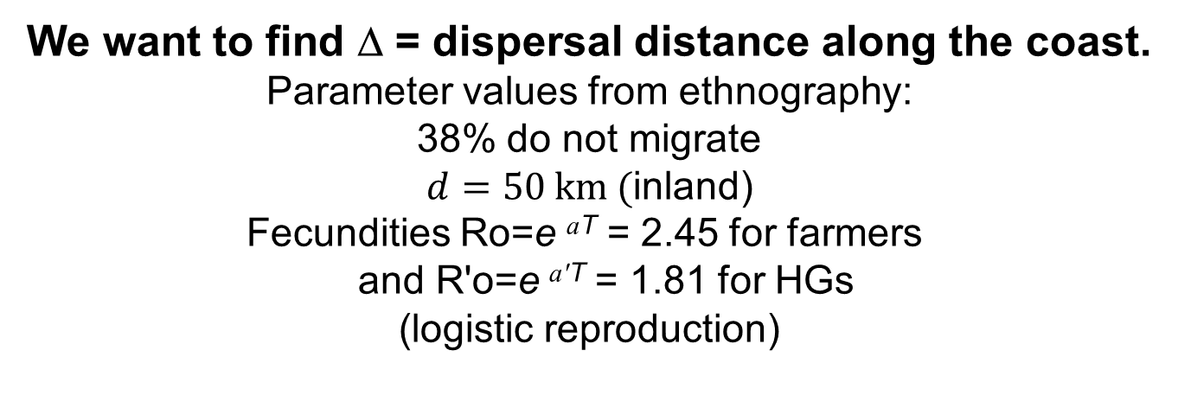
First model Second model
Forward and backward dispersal Forward dispersal only
farmers t=0
We want to find Δ = dispersal distance along the coast.
Parameter values from ethnography:
38% do not migrate
$d=50 km ($inland)
Fecundities Ro=e ^{aT} = 2.45 for farmers
and R'o=e ^{a'T} = 1.81 for HGs
(logistic reproduction)

Slide 4
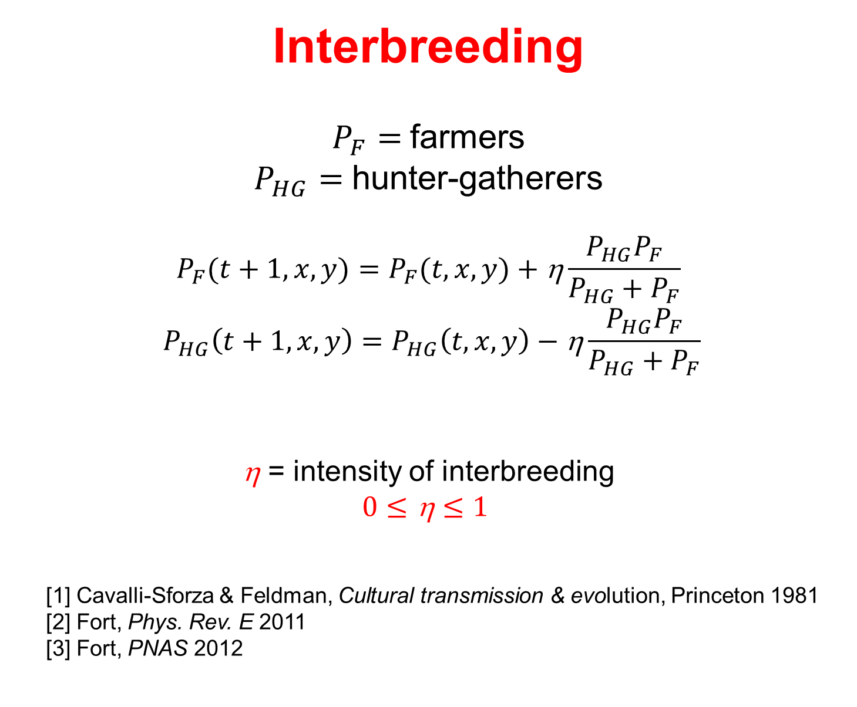
Interbreeding
$P_{F}=$farmers
$P_{HG}=$hunter-gatherers
$$P_{F}(t+1, x,y)=P_{F}(t, x,y) \text{+} \text{η}\frac{P_{HG}P_{F}}{P_{HG}+P_{F}}$$
$$P_{HG}\left(t+1, x,y\right)=P_{HG}\left(t, x,y\right)−\text{η}\frac{P_{HG}P_{F}}{P_{HG}+P_{F}}$$
$\text{}$ = intensity of interbreeding
$$0≤\text{η}≤1$$
[1] Cavalli-Sforza & Feldman, Cultural transmission & evolution, Princeton 1981
[2] Fort, Phys. Rev. E 2011
[3] Fort, PNAS 2012

Slide 5
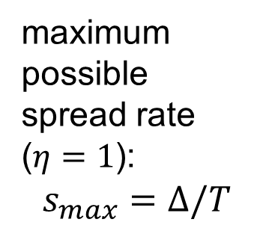


FIRST MODEL
maximum
possible
spread rate ($η=1$):
$$s_{max}=Δ/T$$
$Δ$*
archaeological data: 7.5-10.6 km/yr
(slide #2)
$$Results from$$
$$this figure:$$
$Δ_{min}=$ 240 km
$Δ_{max}=$ 427 km

Slide 6
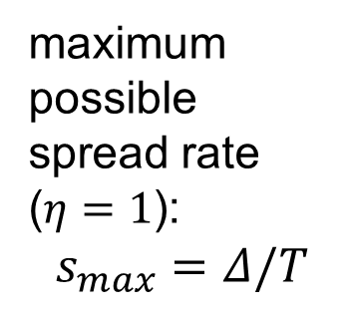


SECOND MODEL
$Δ$*
maximum
possible
spread rate ($η=1$):
$$s_{max}=Δ/T$$
archaeological data: 7.5-10.6 km/yr
(slide #2)
$$Results from$$
$$this figure:$$
$Δ_{min}=$ 240 km
$Δ_{max}=$ 343 km

Slide 7
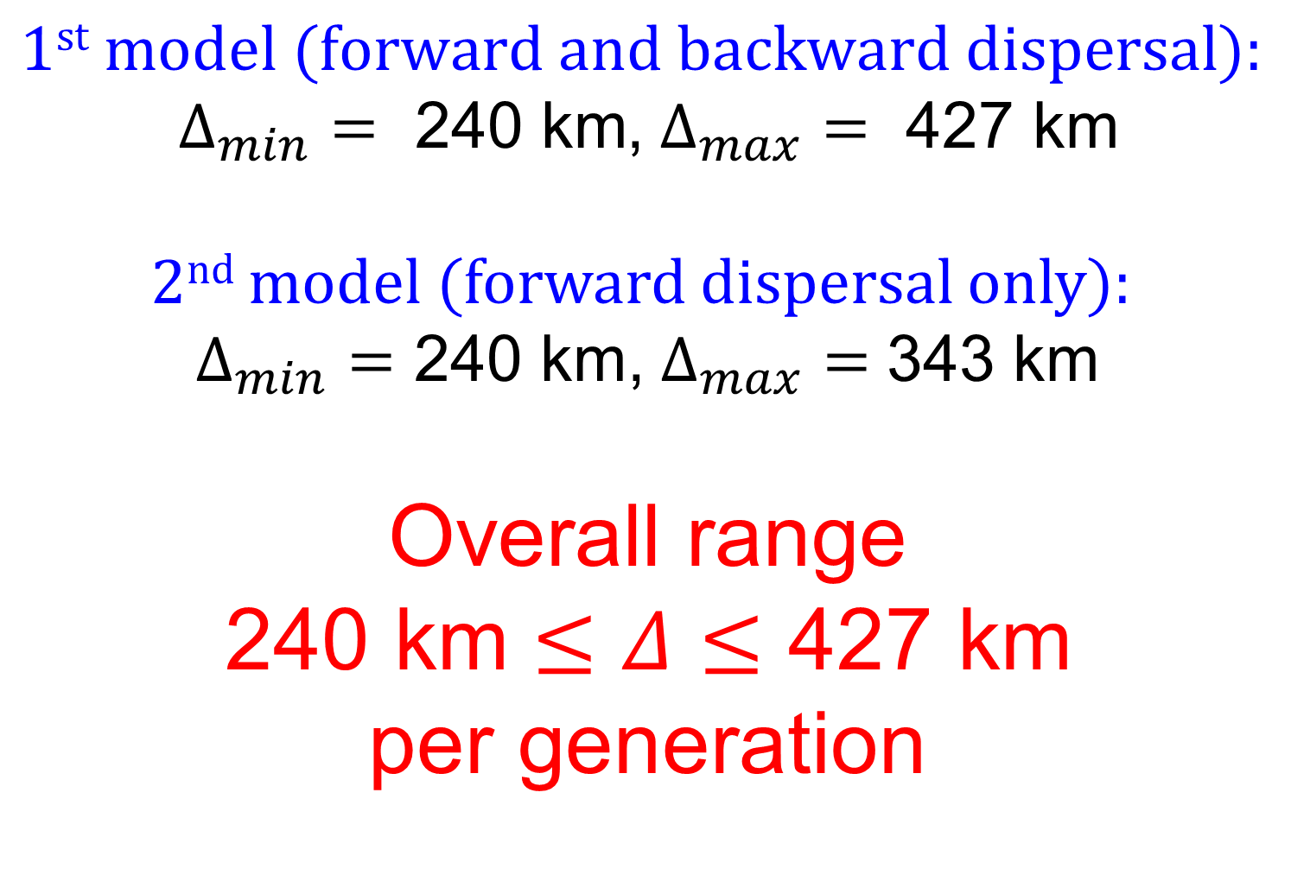
Results
$$1st \text{model}\text{ (}\text{forward} \text{and} \text{backward} \text{dispersal}\text{):}$$
$Δ_{min}=\text{ 240 }\text{km}$,$Δ_{max}= \text{427} \text{km}$
$2nd$ model (forward dispersal only):
$Δ_{min}=$ 240 km,$Δ_{max}=$ 343 km
Overall range
$\text{240 }\text{km}≤Δ≤\text{427 }\text{km}$
per generation

Slide 8
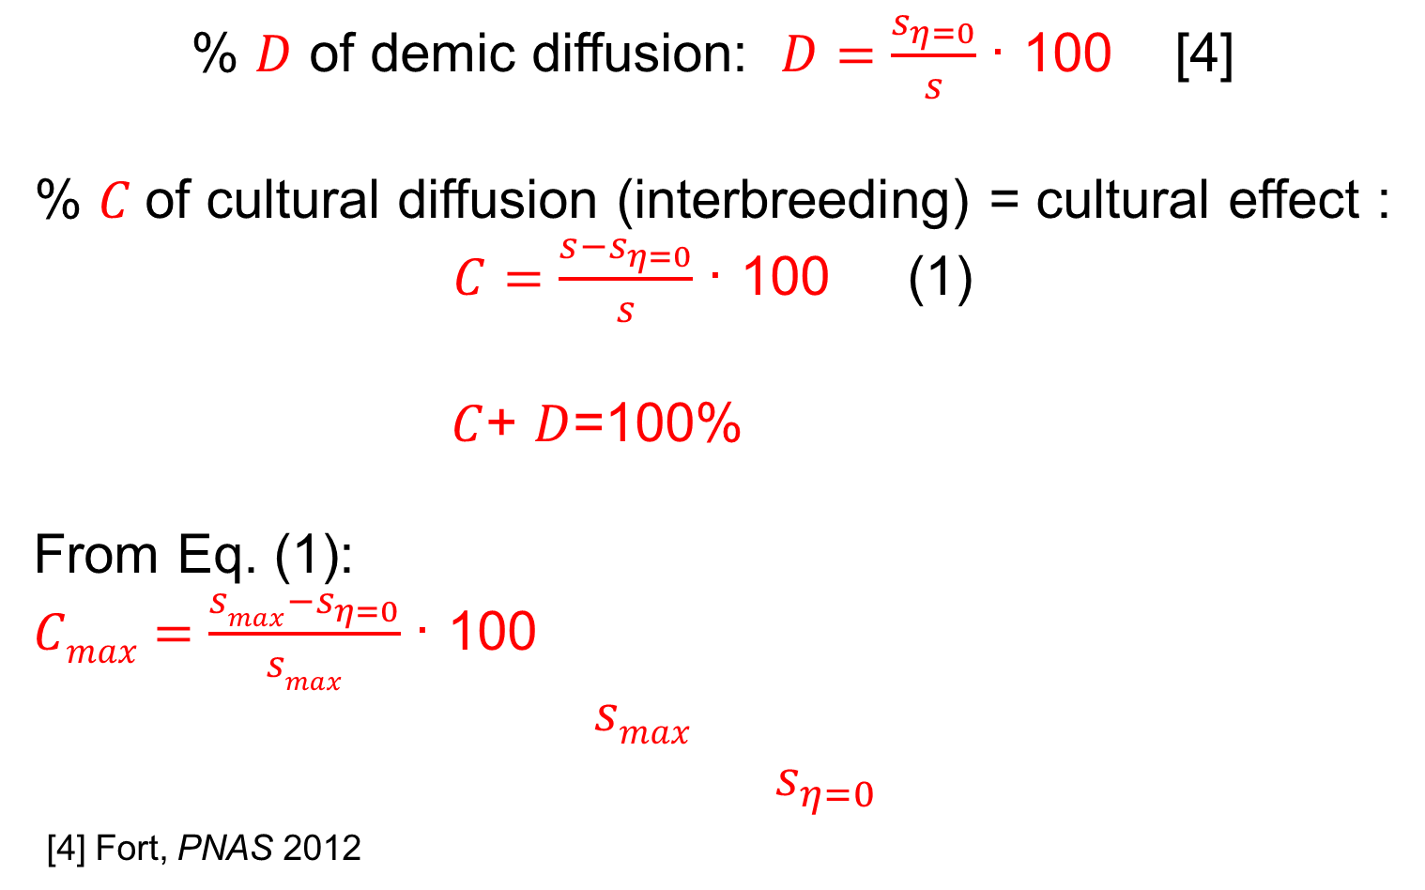
%s of demic and cultural diffusion
% $D$ of demic diffusion: $D=\frac{s_{η=0}}{s}$· 100 [4]
% $C$of cultural diffusion (interbreeding) = cultural effect :
$C=\frac{s−s_{η=0}}{s}$· 100 (1)
$C$+ $D$=100%
From Eq. (1):
$Cmax=\frac{smax−s_{η=0}}{smax}$· 100
$smax$
$s_{η=0}$
[4] Fort, PNAS 2012

Slide 9
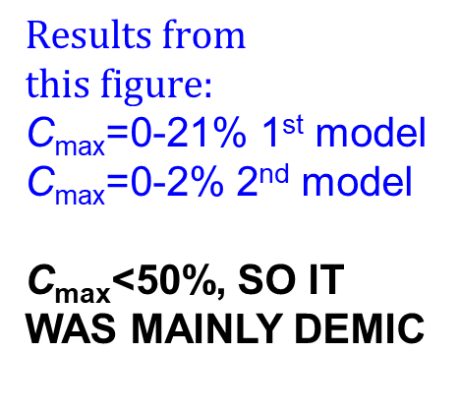
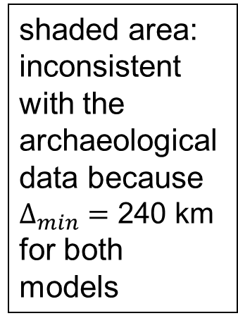
shaded area:
inconsistent
with the archaeological
data because
$Δ_{min}=$ 240 km
for both models
$$Results from$$
$$this figure:$$
C_{max}=0-21% 1st model
C_{max}=0-2% 2nd model
C_{max}<50%, SO IT WAS MAINLY DEMIC
C_{max}=

Slide 10
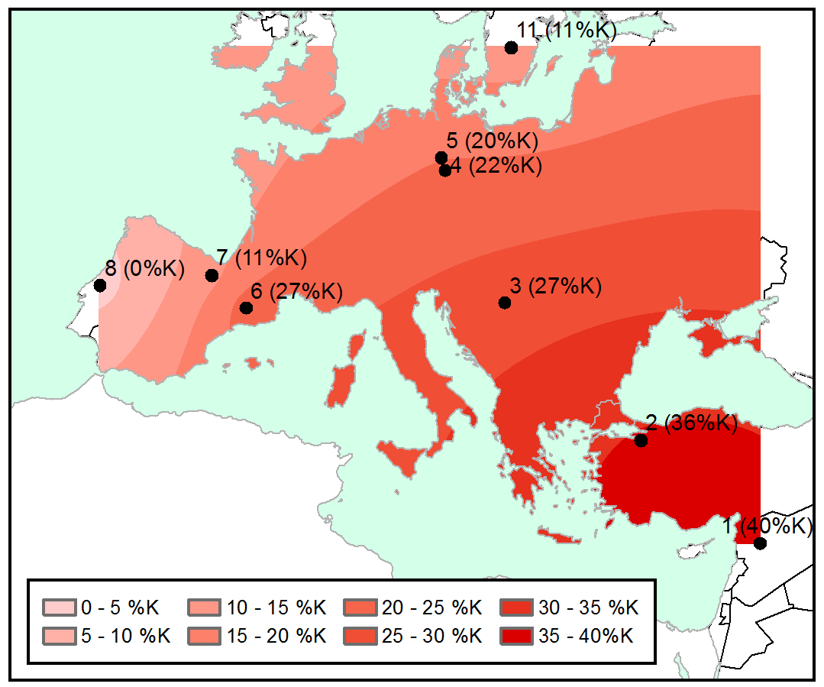
Ancient genetics
mtDNA haplogroup K: absent in hunter-gatherers
This
pattern
(cline)
suggests
interbreeding
Isern,
Fort &
de Rioja,
Sci. Rep. (2017)

Slide 11
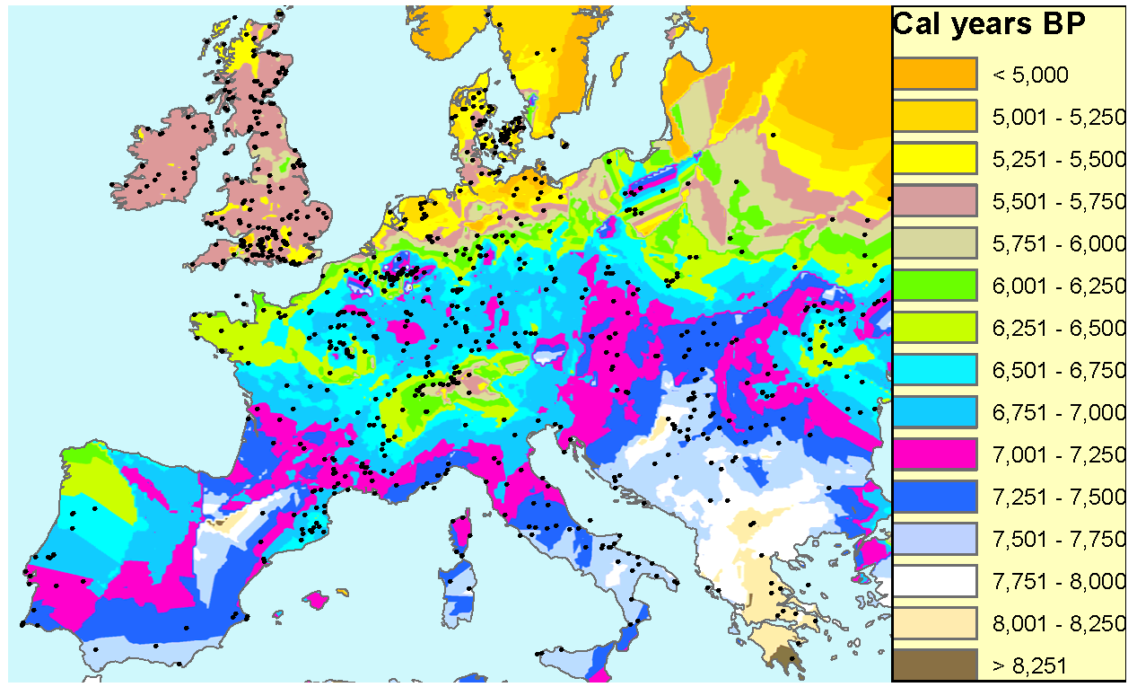
Two routes
inland
route
sea route
Now (year 2024) we have ancient genetic
data for both routes
Interpolation of archaeological dates from Fort, J. R. Soc. Interface (2015)

Slide 12
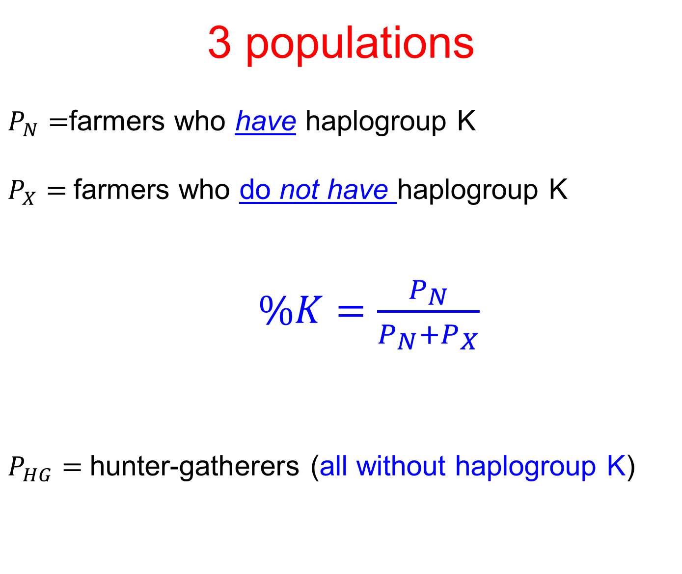
3 populations
$P_{N}=$farmers who have haplogroup K
$P_{X}=$farmers who do not have haplogroup K
$\%K=\frac{P_{N}}{P_{N}+P_{X}}$
$P_{HG}=$hunter-gatherers (all without haplogroup K)

Slide 13
Inland genetic cline
SIMULATIONS
Fort & Pérez-Losada,
Nature Comm. 2024
Best fits: η = 0.07-0.08

Slide 14
Mediterranean genetic cline
SIMULATIONS
Fort & Pérez-Losada,
Nature Comm. 2024
Best fits: η = 0.06-0.07. Essentially the same!

Slide 15
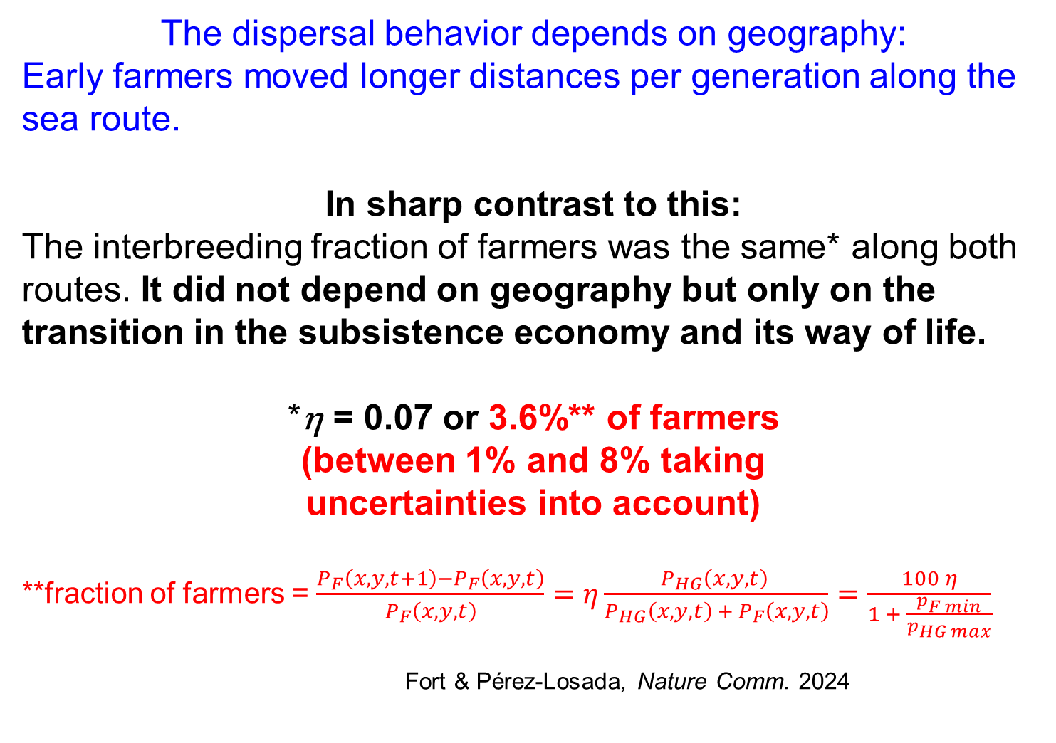
Conclusions
The dispersal behavior depends on geography:
Early farmers moved longer distances per generation along the sea route.
In sharp contrast to this:
The interbreeding fraction of farmers was the same* along both routes. It did not depend on geography but only on the transition in the subsistence economy and its way of life.
*η = 0.07 or 3.6%** of farmers
(between 1% and 8% taking
uncertainties into account)
**fraction of farmers = $\frac{P_{F}\left(x,y,t+1\right)−P_{F}\left(x,y,t\right)}{P_{F}\left(x,y,t\right)}=η\frac{P_{HG}\left(x,y,t\right) }{P_{HG}\left(x,y,t\right) +{ P}_{F}\left(x,y,t\right)}=\frac{100 η}{1 + \frac{p_{F min}}{p_{HG max}}}$
Fort & Pérez-Losada, Nature Comm. 2024

