Slide 1
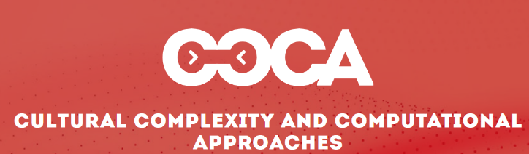



From Complicated Models to Complex Dynamics:
The Computer Simulation of Prehistoric Social Worlds
JUAN A. BARCELÓ
Joaquim Fort
Universitat de Girona
Albert García Piquer
Universitat Autònoma de Barcelona
Olga Palacios
Durham University
Ramón Buxó
Museu d’Arqueologia de Catalunya
Jaume Noguera
Universitat Autònoma de Barcelona

Slide 2
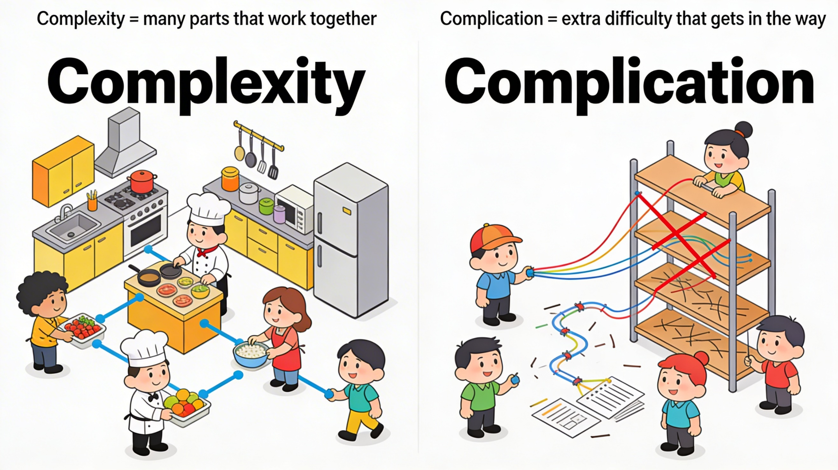
Image created by the autor using PerplexityAI

Slide 3
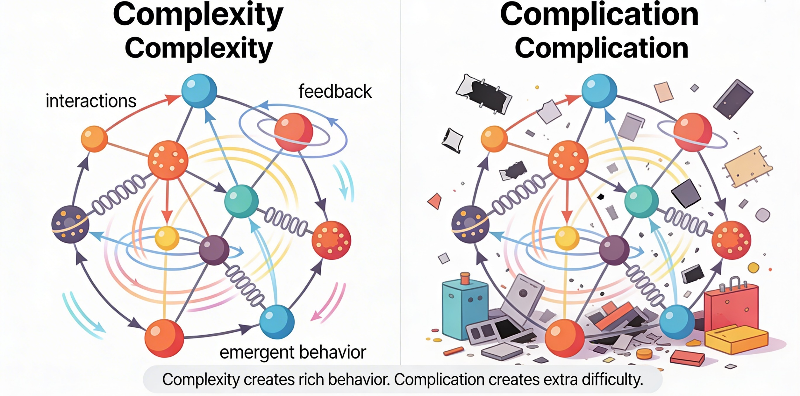
Image created by the autor using PerplexityAI

Slide 4
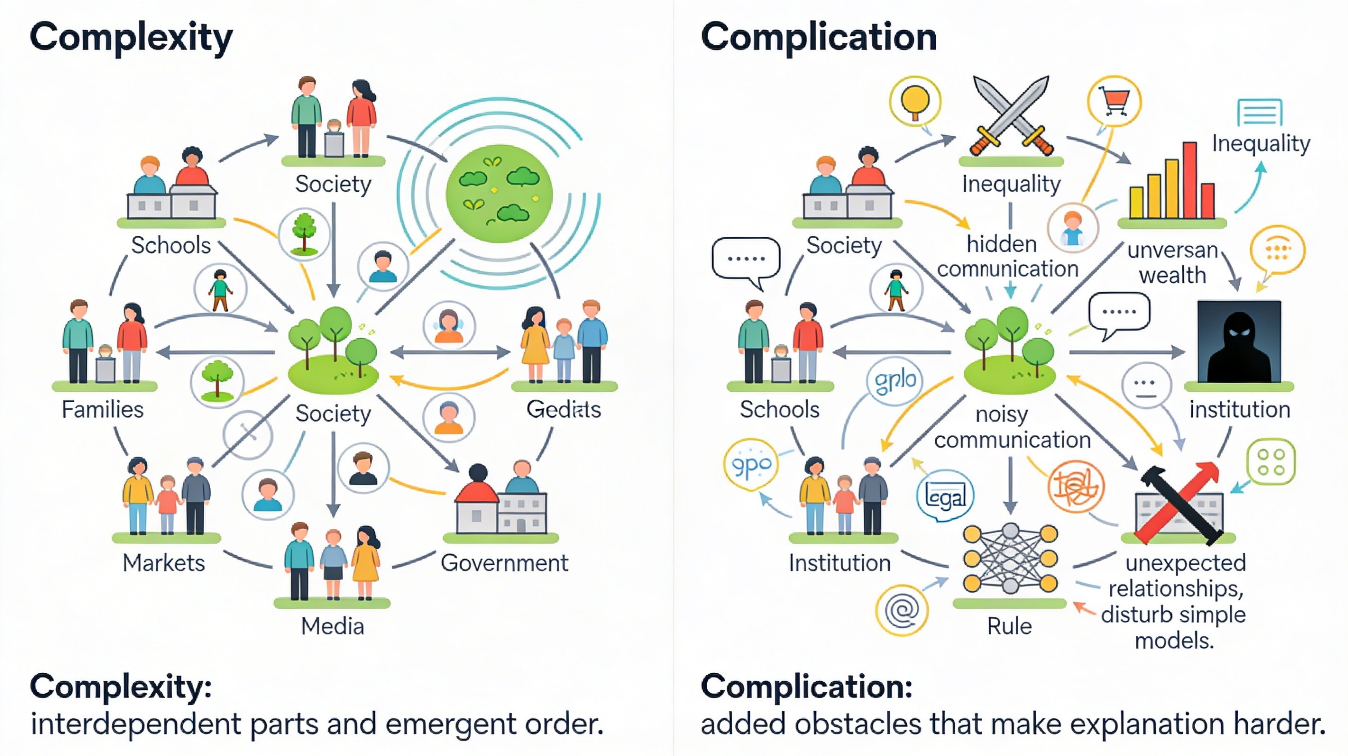
Image created by the autor using PerplexityAI

Slide 5
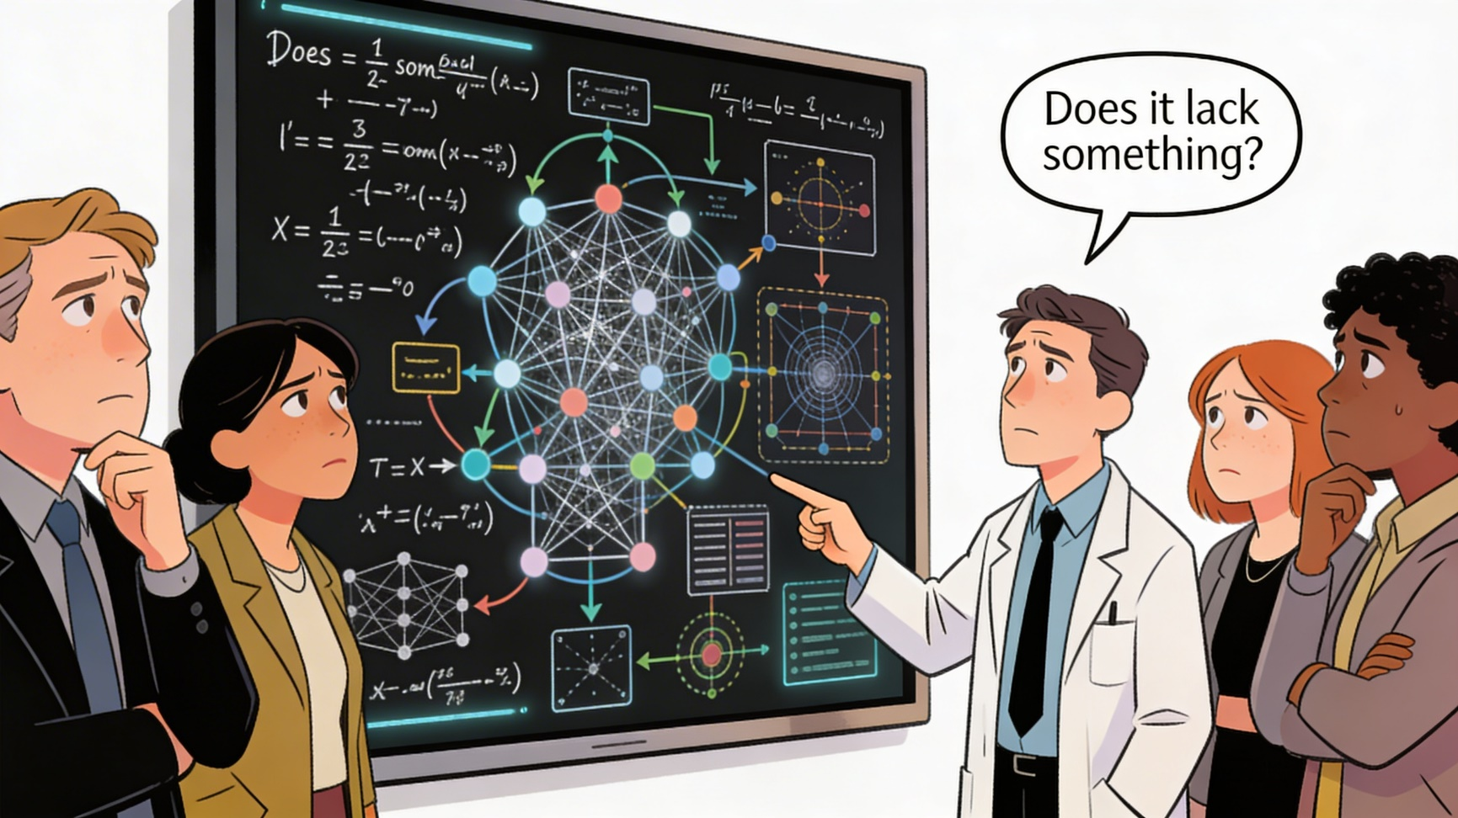
Image created by the autor using PerplexityAI

Slide 6
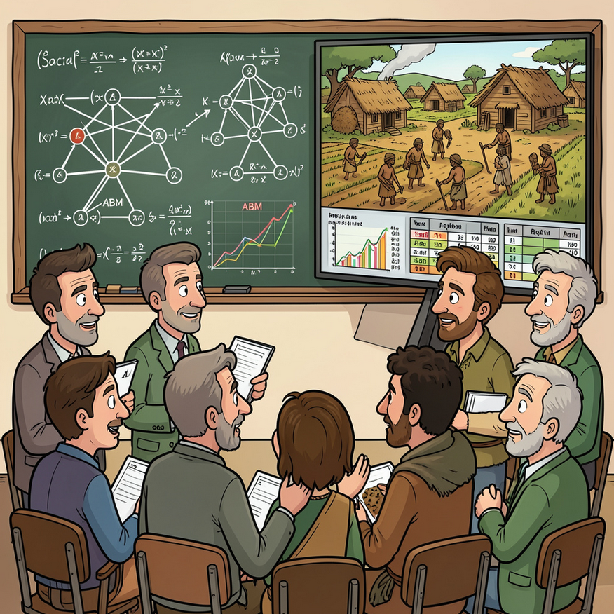
Neolithic as a case study

Slide 7
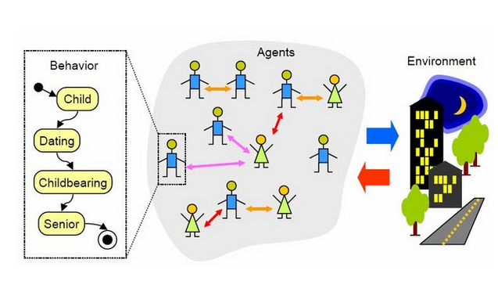
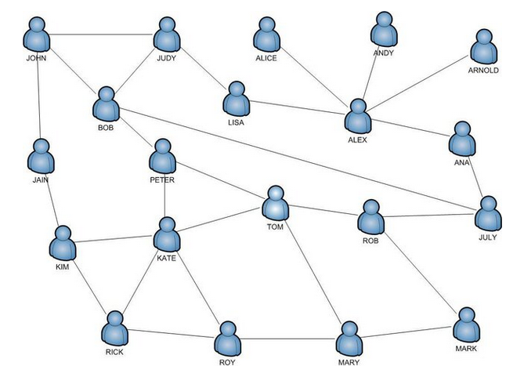
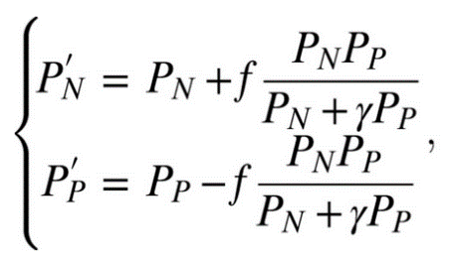
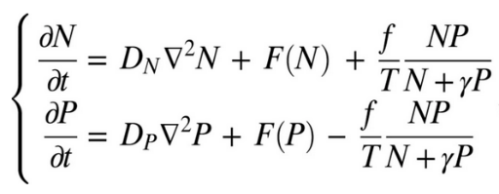
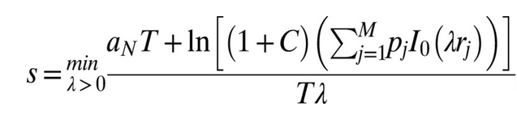
THREE TYPES OF MODELS
EQUATION-BASED MODELS AGENT BASE MODELS SOCIAL NETWORKS
Filipowski, T., Kazienko, P., Brodka, P., & Kajdanowicz, T. (2012). Web-based knowledge exchange through social links in the workplace. Behaviour & Information Technology, 31(8), 779-790.
Fort, J. (2015). Demic and cultural diffusion propagated the Neolithic transition across different regions of Europe. Journal of the Royal Society interface, 12(106).
Metcalf, S. S. (2007). Simulating the social dynamics of spatial disparity through neighborhood network evolution. University of Illinois at Urbana-Champaign.

Slide 8
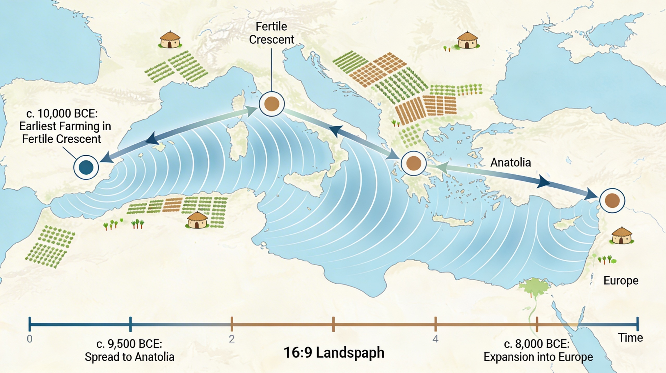
SPATIO-TEMPORAL MODELS
Image created by the autor using PerplexityAI

Slide 9
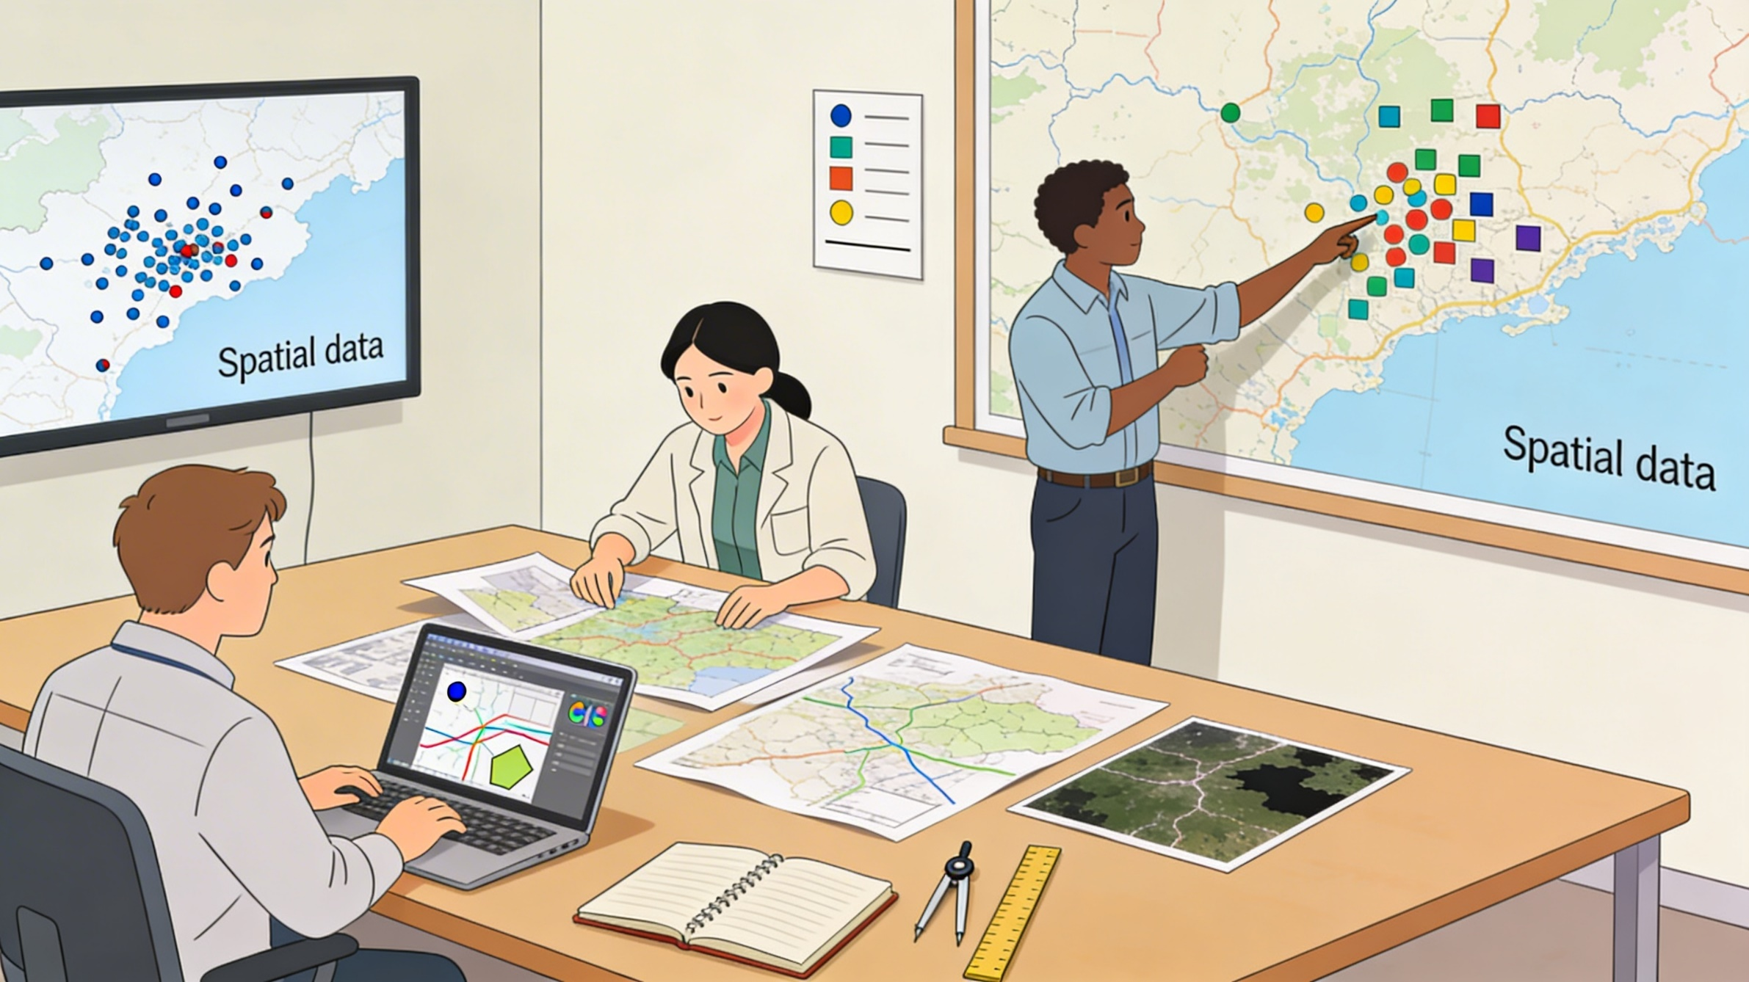
Spatial information is always explicit

Slide 10

Explicit time occurs when the model directly incorporates empirical chronological information, such as dated observations tied to specific spatial coordinates.

Slide 11
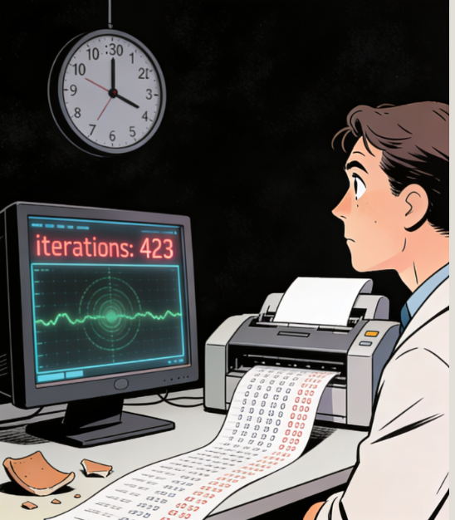
Emergent time operates differently.
Modeled events are not initially tied to calendar years but arise through repeated iterations of behavioral or demographic cycles. The number of iterations defines the internal temporal structure of the model.

Slide 12
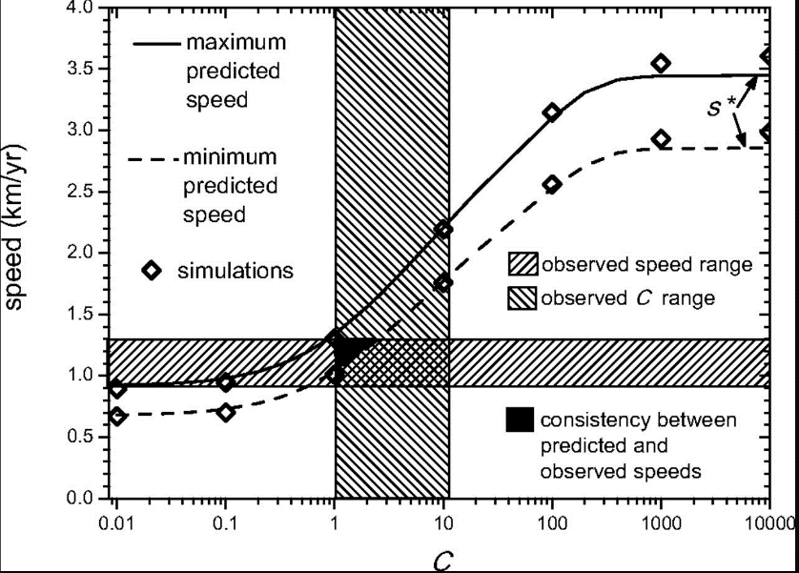
THREE TYPES OF CHRONOLOGICAL MODELS
EQUATION-BASED MODELS
Reaction-Diffusion (RD) model.
It describes how population density grows locally and disperses across space, capturing the spatio-temporal dynamics of expansion.
Fort, J. (2012). Synthesis between demic and cultural diffusion in the Neolithic transition in Europe. Proceedings of the National Academy of Sciences, 109(46), 18669-18673.

Slide 13
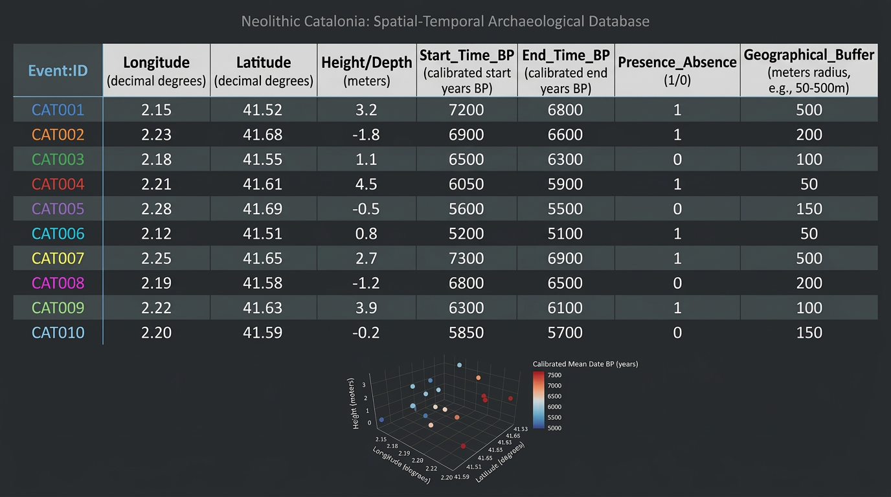

Slide 14
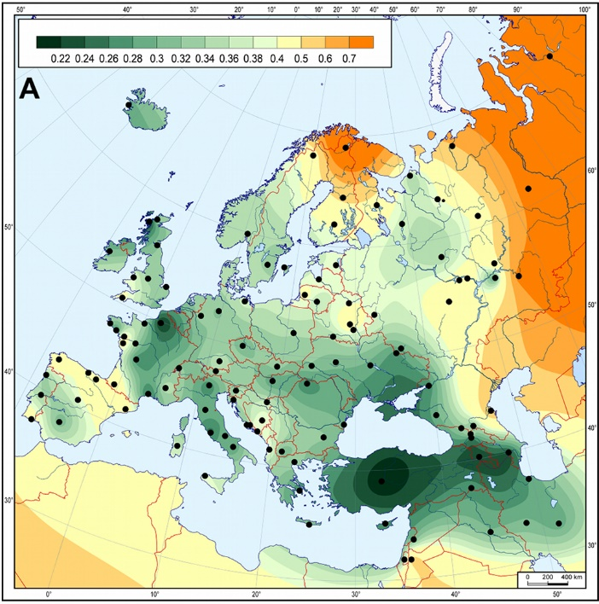
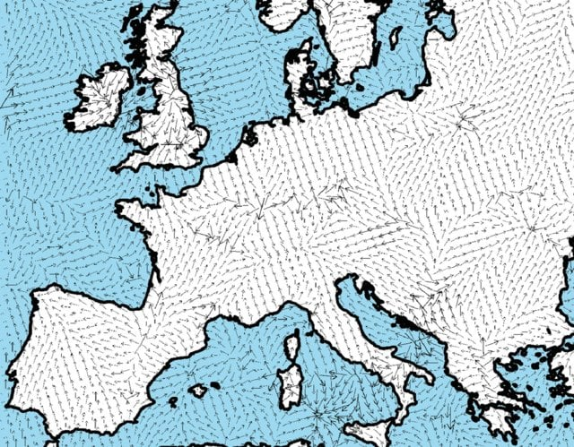
THREE TYPES OF CHRONOLOGICAL MODELS
EQUATION-BASED MODELS
However, input archaeological data cannot always be treated as simple points on a map.
We should implement the reaction-diffusion model by replacing fixed locations and dates with spatial and temporal probability distributions defined by the confidence intervals. The model then propagates uncertainty through the simulation.
.
Cooper, Alan (9 November 2010). "Ancient DNA from European Early Neolithic Farmers Reveals Their Near Eastern Affinities". PLOS Biology. 8 (11) e1000536. doi:10.1371/journal.pbio.1000536
Fort, J. (2015). Demic and cultural diffusion propagated the Neolithic transition across different regions of Europe. Journal of the Royal Society interface, 12(106).

Slide 15
Reaction-diffusion models compress a historically messy process into a simplified spatio-temporal structure, in which the spatio-temporal dynamics of a single dependent variable is considered.
Therefore, they are best used as parsimonious baselines, not as complete explanations.

Slide 16
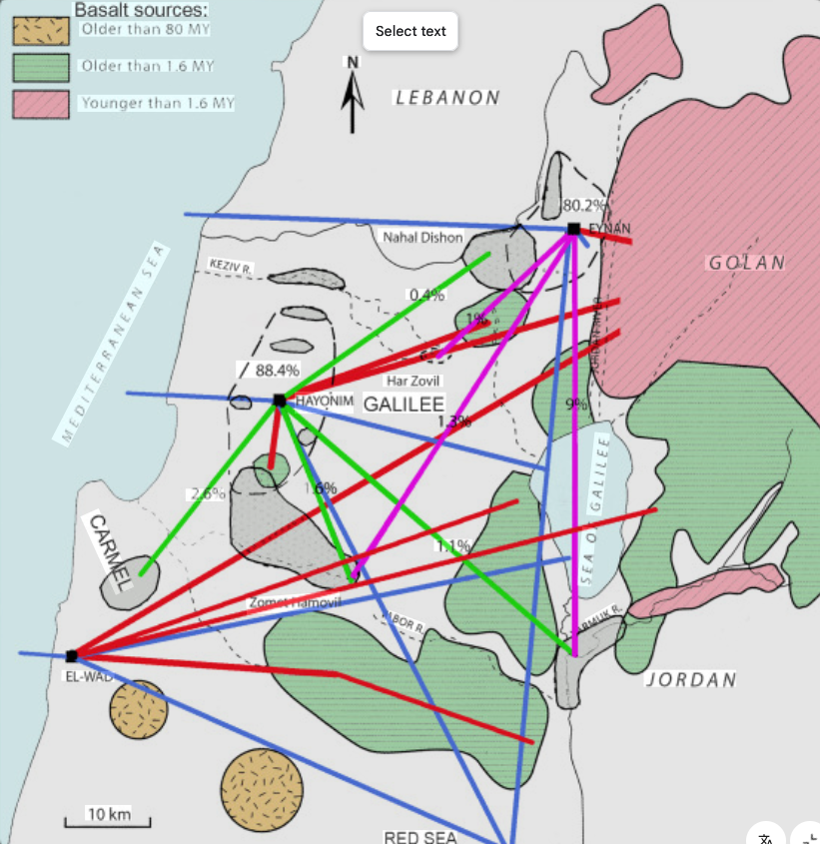
THREE TYPES OF CHRONOLOGICAL MODELS
SOCIAL NETWORKS
A social network model represents communities as nodes and their interaction channels—exchange, intermarriage, seasonal mobility—as links.
Goring-Morris, N., & Cohen, A. B. (2022). ‘Far and wide’: Social networking in the Early Neolithic of the Levant. L'Anthropologie, 126(3), 103051.

Slide 17
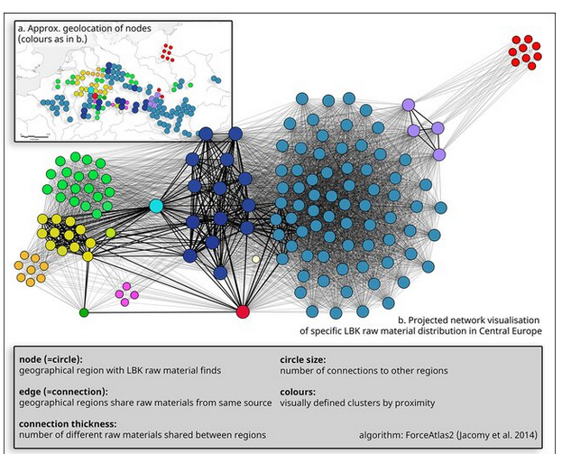
THREE TYPES OF CHRONOLOGICAL MODELS
NETWORK MODELS
The degree of node distribution, their possible clustering, and presence of hubs or bridges configure the topology of the network, and it can be used to analyze the underlying process.
Kerig, T., Hilpert, J., Strohm, S., Berger, D., Denis, S., Gauthier, E., ... & Wilkinson, T. (2023). Interlinking research: the Big Exchange project. Antiquity, 97(394), e22.

Slide 18
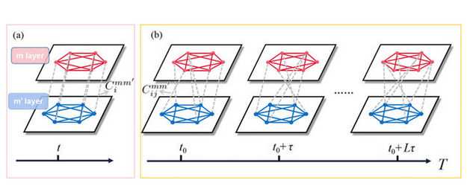
THREE TYPES OF CHRONOLOGICAL MODELS
NETWORK MODELS
To build a diachronic network of prehistoric settlements, we may construct separate network slices for successive time intervals.
This allows us to analyze changing interactions, hierarchies, clustering, and regional integration over time.
Li, X., Ghosh, D., Lei, Y., & Small, M. (2025). Synchronization and chimera states in time-varying multilayer networks with higher-order interactions. Chaos: An Interdisciplinary Journal of Nonlinear Science, 35(5).

Slide 19

Image created by the autor using PerplexityAI

Slide 20
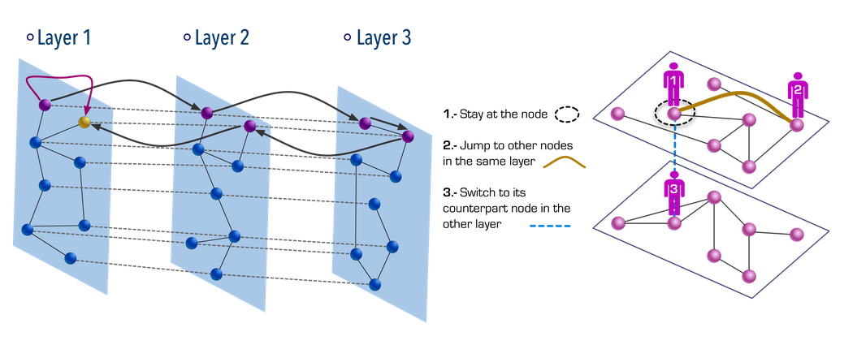
MULTIPLEX
A multiplex network represents the same nodes connected by multiple layers of links, each layer encoding a different type of interaction.
Q. Guo, E. Cozzo, Z. Zheng, and Y. Moreno, Lévy random walks on multiplex networks. Scientific Reports 6:37641 (2016).

Slide 21
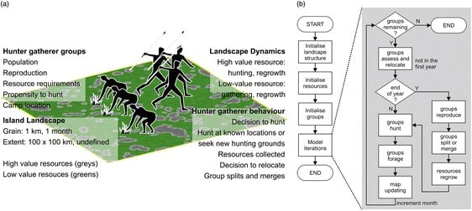
THREE TYPES OF CHRONOLOGICAL MODELS
AGENT BASE MODELS
Individual agents take decisions following simple rules, interact with other agents constrained by environmental conditions, and transform their environment in consequence, both social and natural.
From micro-level interactions, macro-level patterns may emerge.
Perry, G. L., & O’Sullivan, D. (2018). Identifying narrative descriptions in agent-based models representing past human-environment interactions. Journal of Archaeological Method and Theory, 25(3), 795-817..

Slide 22
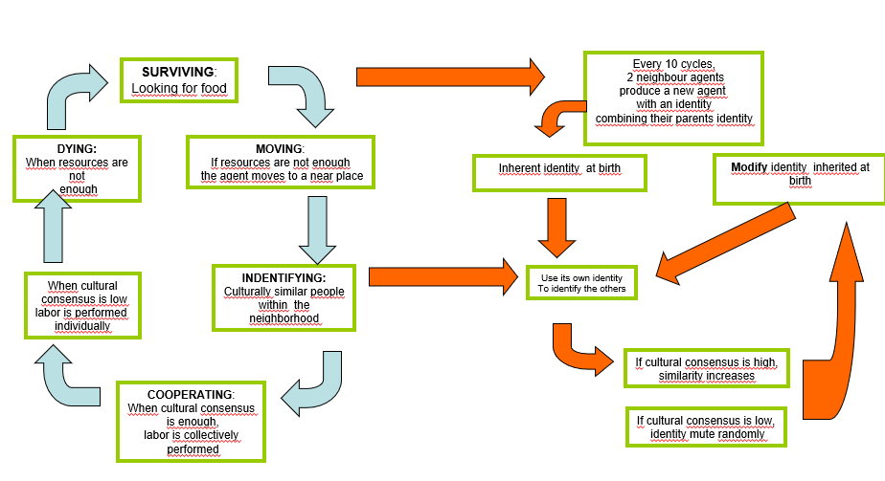
THREE TYPES OF CHRONOLOGICAL MODELS
AGENT BASE MODELS
Simulation time becomes emergent:
time emerges from repeated behavioral cycles and feedback loops.
When the cycle has a prefigured temporal duration, its repeated iteration configures temporal dynamics.
This makes such models especially useful for representing dynamic processes of change and adaptation.
Barceló, J.A., Del Castillo Bernal, F., 2020, When All Agents Die: Analyzing the “Failures” in an Agent-Based Model of Human Foraging. DOI. 10.15496/publikation-43216.

Slide 23
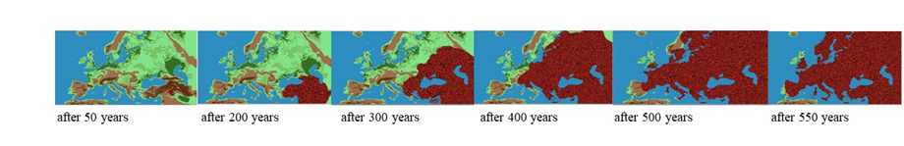
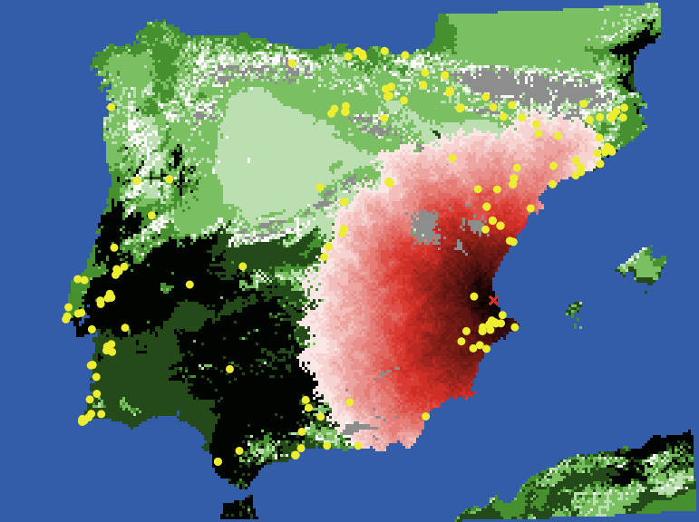
Barceló, Palacios, Mameli, 2026 . in press. BAR Publishing. Oxford.
Sean Bergin, Michael Barton, Salvador Pardo Gordo, Joan Bernabeu Auban (2015, October 16). “Neolithic Spread Model Version 1.0” (Version 1.4.0). CoMSES Computational Model Library. Retrieved from: https://www.comses.net/codebases/4447/releases/1.4.0/

Slide 24
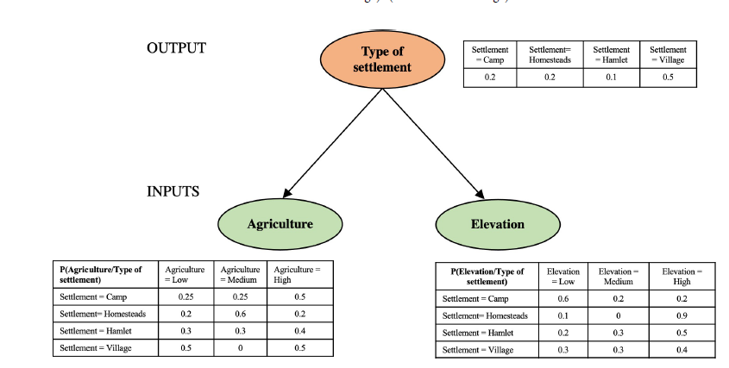
Palacios, O., Barceló, J. A., & Delgado, R. (2022). Exploring the role of ecology and social organisation in agropastoral societies: A Bayesian network approach. Plos one, 17(10), e0276088.

Slide 25

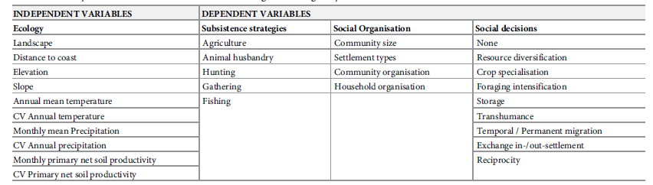
Palacios, O., Barceló, J. A., & Delgado, R. (2022). Exploring the role of ecology and social organisation in agropastoral societies: A Bayesian network approach. Plos one, 17(10), e0276088.

Slide 26
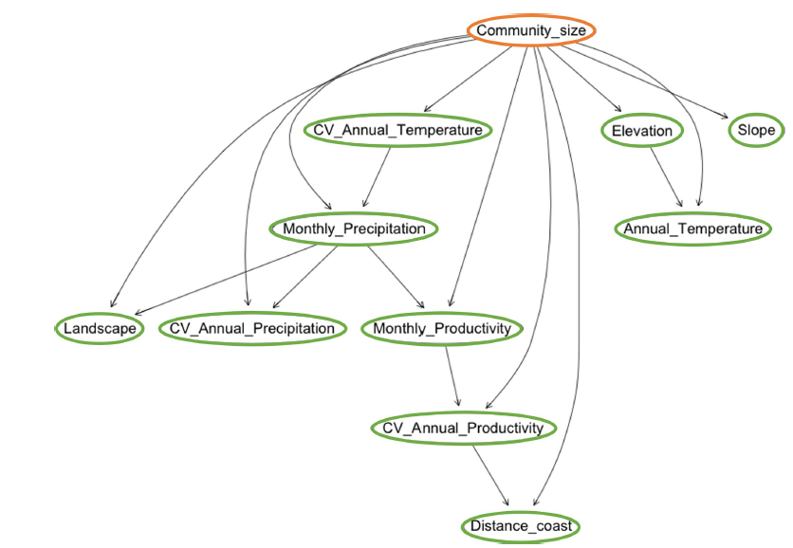
Palacios, O., Barceló, J. A., & Delgado, R. (2022). Exploring the role of ecology and social organisation in agropastoral societies: A Bayesian network approach. Plos one, 17(10), e0276088.

Slide 27
Palacios, O., Mameli, L., & Barceló, J. A. (2026). Surviving in the early Neolithic. Causal networks and complex systems in archaeology. Journal of Archaeological Science: Reports, 70, 105602.

Slide 28
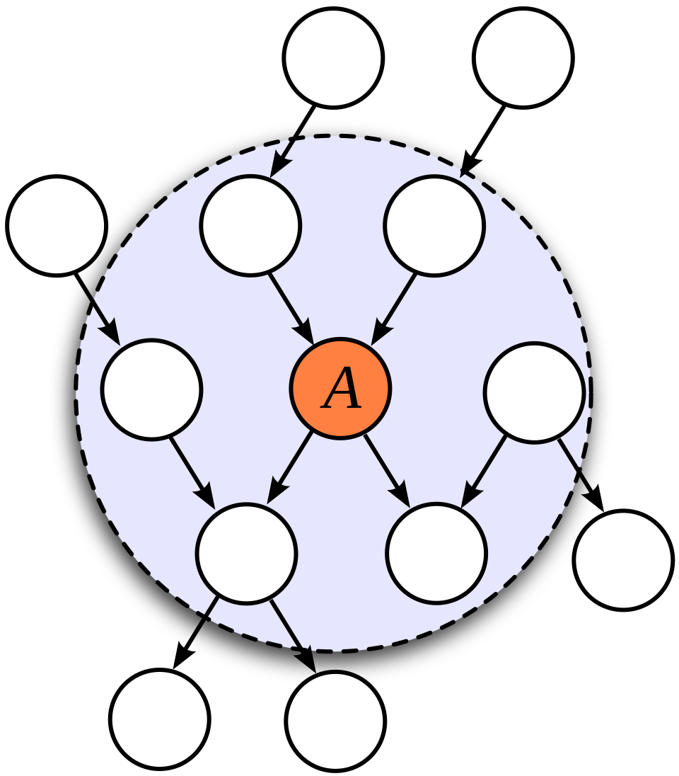
MARKOV CONDITION: Each variable is conditionally independent of all its non‑descendants given its parents
© https://en.wikipedia.org/wiki/Markov_blanket

Slide 29
CONCLUSIONS

Slide 30
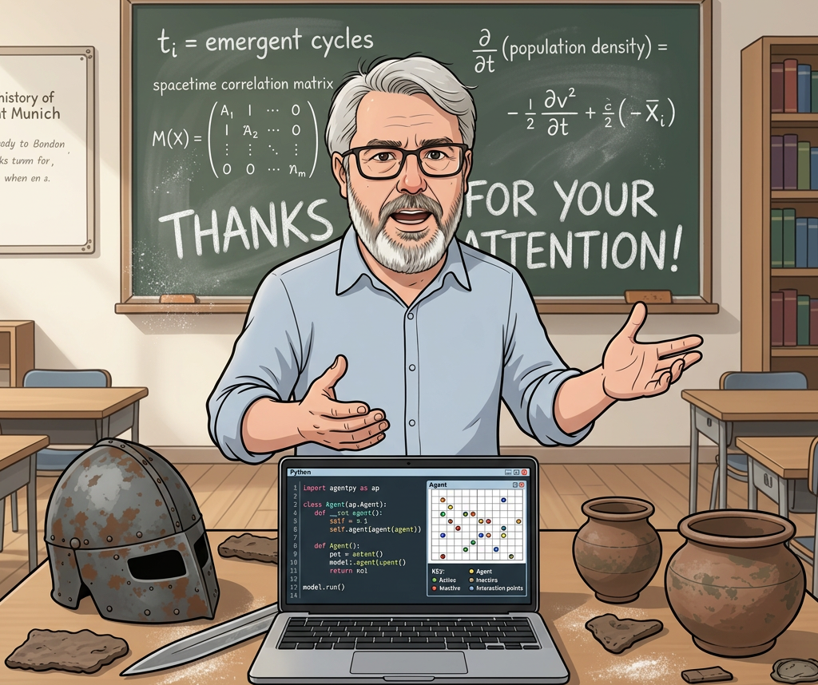
JUAN A. BARCELÓ Juanantonio.barceló@uab.cat

